Slide 1
CSS342 Data Structures, Algorithms, and Discrete Mathematics (I)

Slide 2
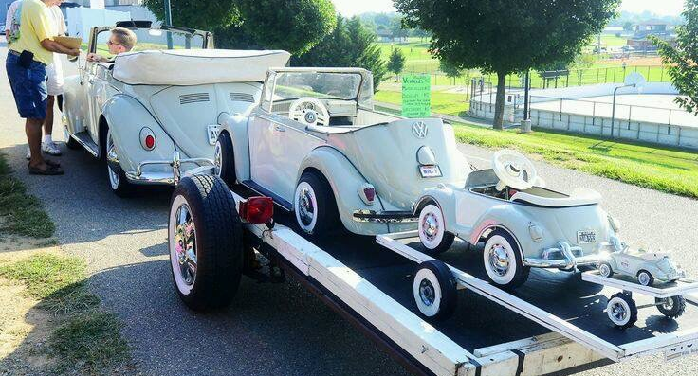
Recursion

Slide 3

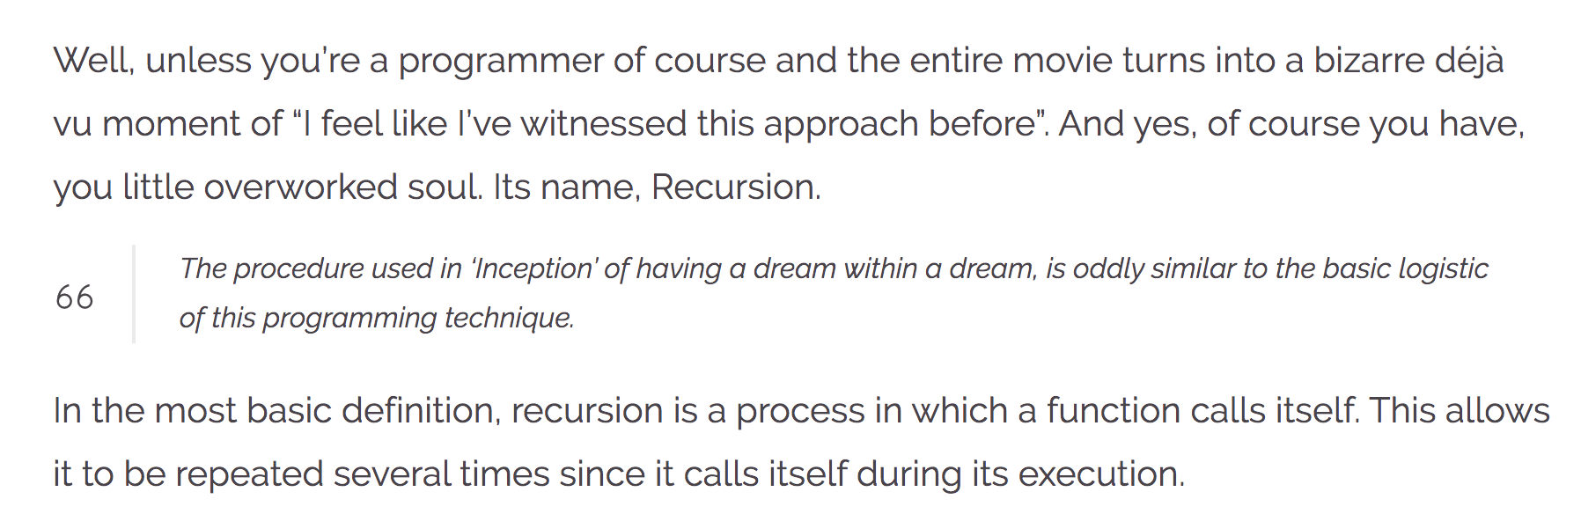
Recursion
https://wewrite.taleas.io/2018/11/14/why-inception-reminds-us-of-recursion/

Slide 4
Recursion

Slide 5
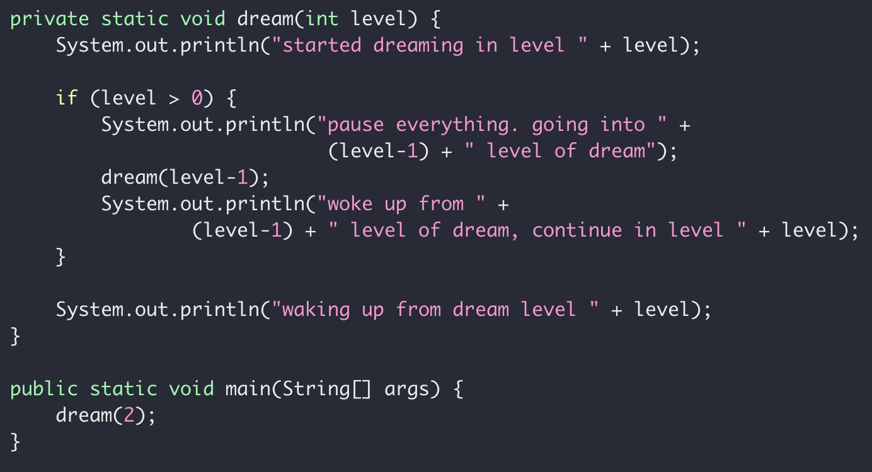
Dream in Recursion

Slide 6
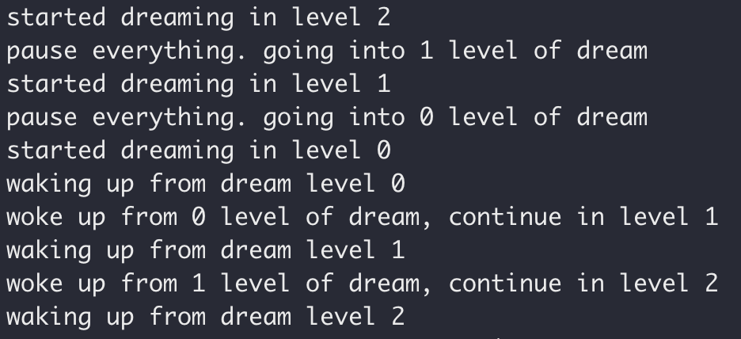
Dream in Recursion

Slide 7
Dream in Dream
Level 2
Level 0
Level 0
Time

Slide 8
Dream in Recursion

Slide 9
Dream in Recursion

Slide 10
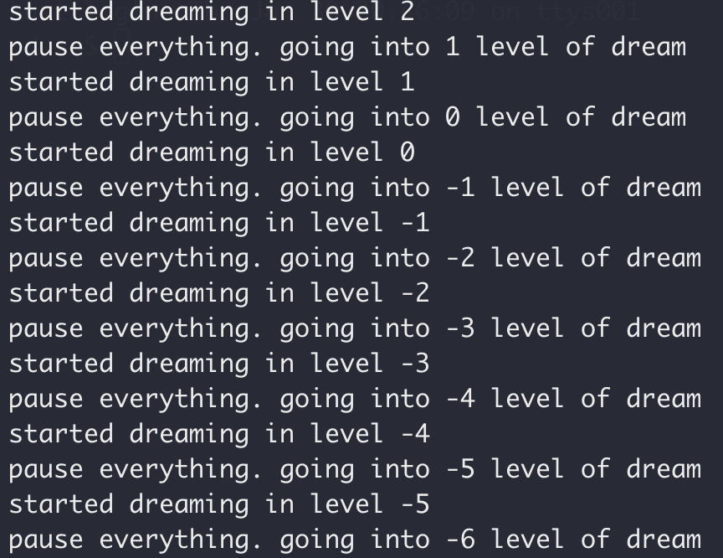
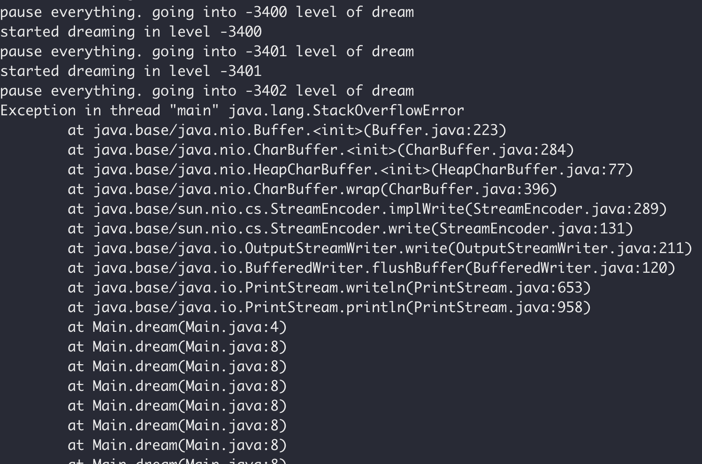
Dream in Recursion

Slide 11
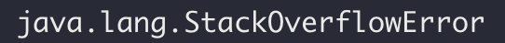
Dream in Recursion

Slide 12
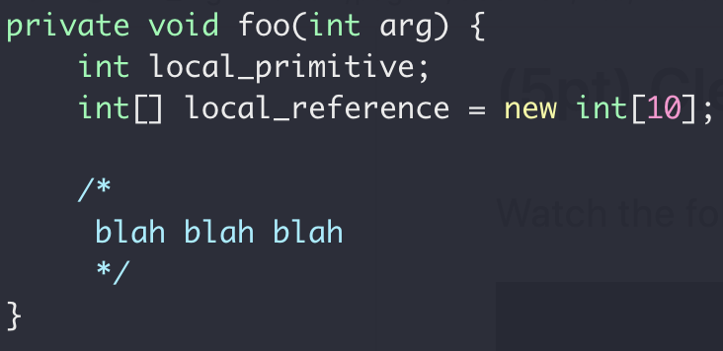
Function Call Stack
Heap
Int[10]
Stack
local_primitive
local_reference
Memory

Slide 13
Memory Map
Virtual Memory

Slide 14
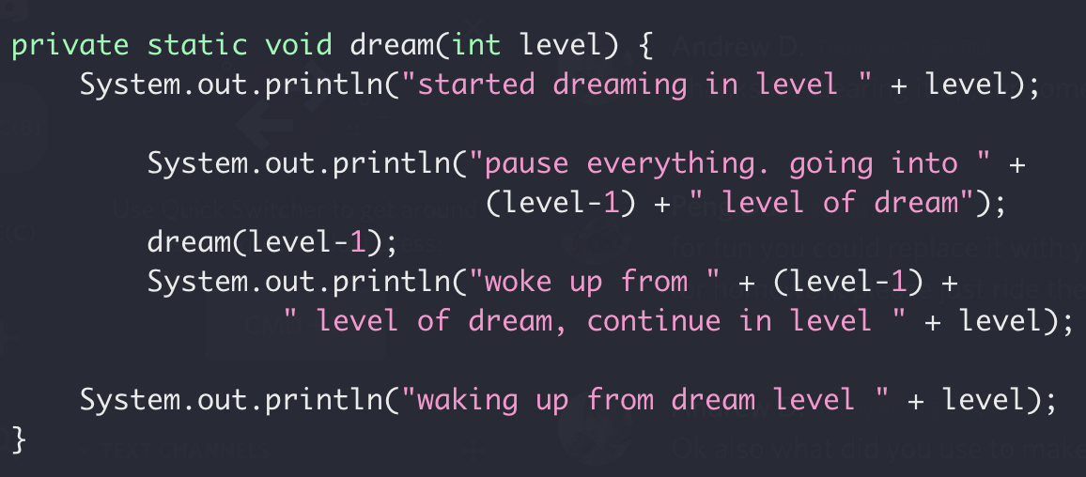
Function Call Stack
Heap
dream(2)
dream(1)
Locals for dream(0)
Return address of dream(1)
Locals for dream(1)
Stack
Return address of dream(2)
Locals for dream(2)
dream(0)
Return address of main()
Memory
More on function call
Stack buffer overflow attack
Notes:
http://www.pythontutor.com/visualize.html#mode=display

Slide 15
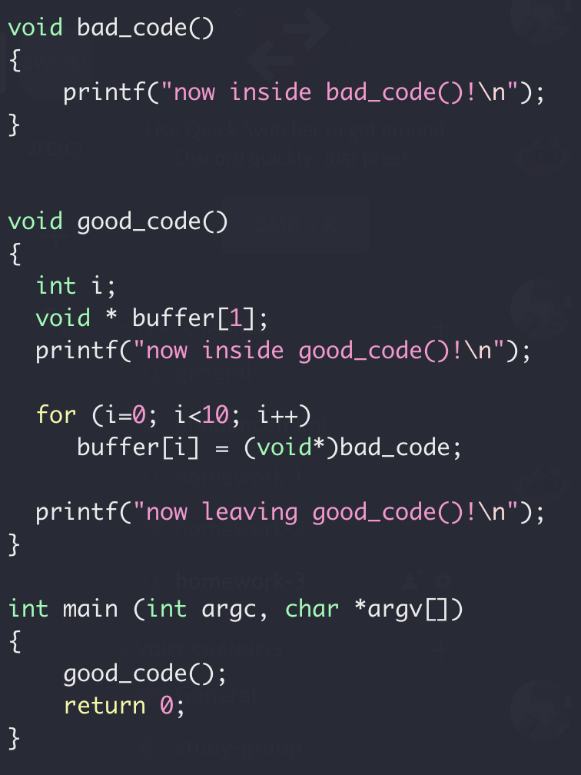
Function Call Stack
Locals for dream(1)
Stack
Return address of dream(2)
Locals for dream(2)
Return address of main()
Memory

Slide 16
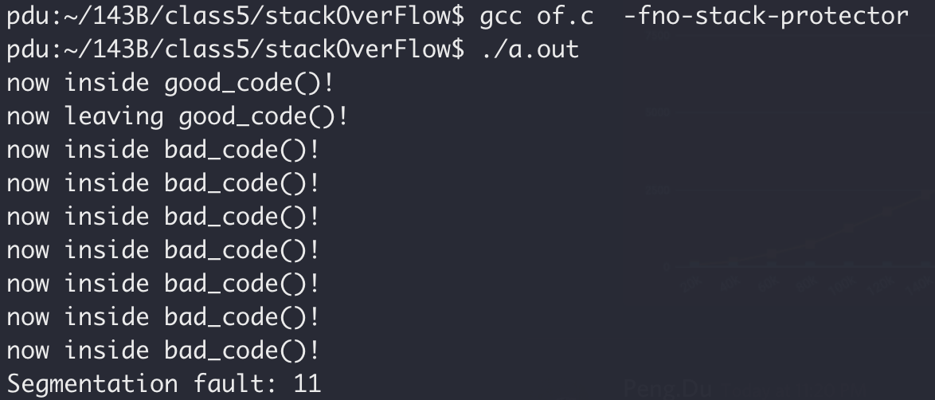
Function Call Stack
Stack smashing

Slide 17
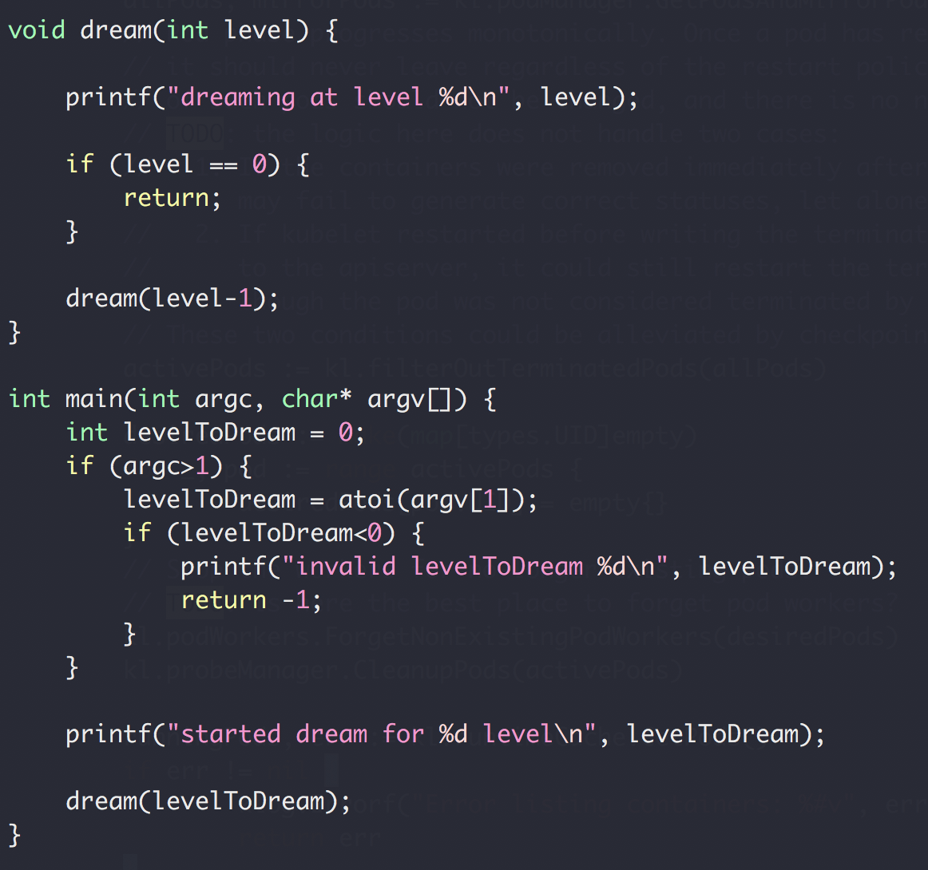
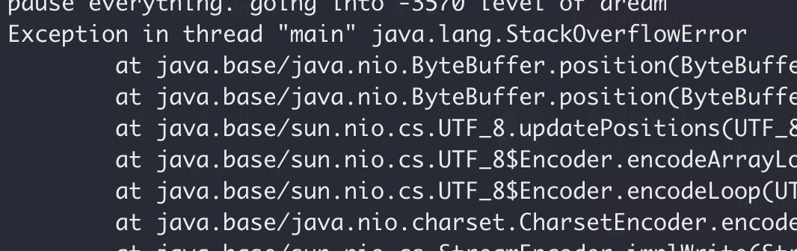
Function Call Stack
Heap
dream(N-4)
Return address of dream(N-3)
dream(N-3)
Return address of dream(N-2)
dream(N-2)
Return address of dream(N-1)
Stack
dream(N-1)
Return address of main()
main()
Memory

Slide 18
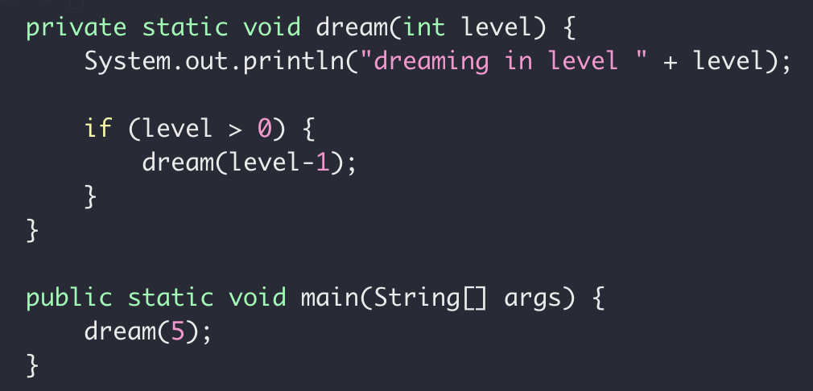
Recursion (and backtracking)
Recursion
Function Calling itself with different parameters (smaller subproblem)
Stop the recursion when the subproblem is ”small enough”
solved directly

Slide 19
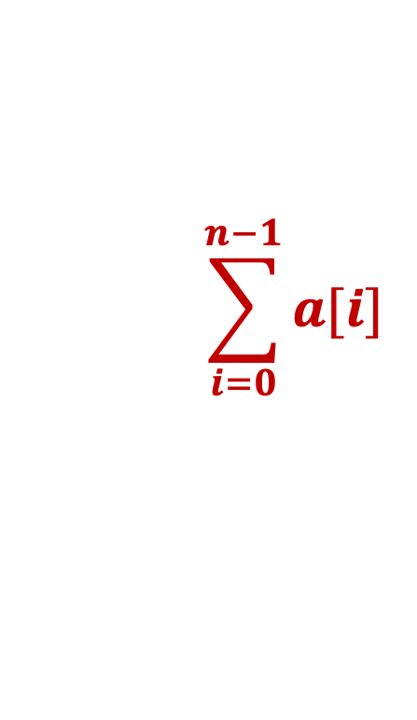
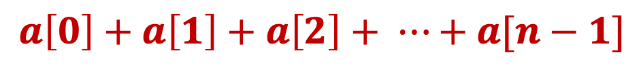
Recursive Sum
Write a function to get the sum of an integer array
$$a\left[0\right]+a\left[1\right]+a\left[2\right]+ ⋯+a[n−1]$$
$$\sum_{i=0}^{n−1}{a[i]}$$

Slide 20
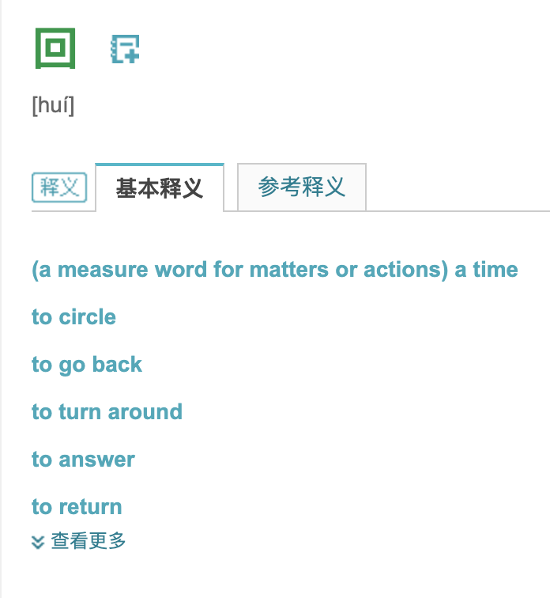
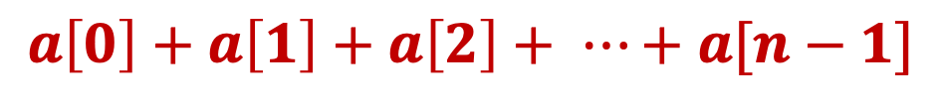
Recursive Sum
Write a function to get the sum of an integer array
$$a\left[0\right]+a\left[1\right]+a\left[2\right]+ ⋯+a[n−1]$$

Slide 21
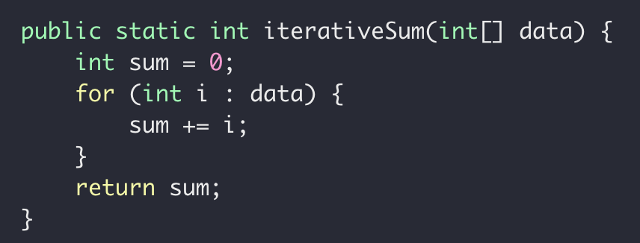
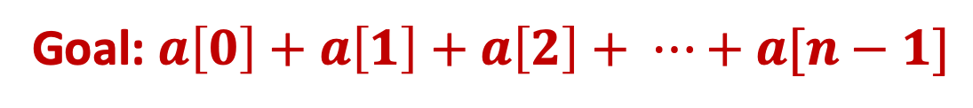
Recursive Sum
Goal: $a\left[0\right]+a\left[1\right]+a\left[2\right]+ ⋯+a[n−1]$
Iteratively

Slide 22
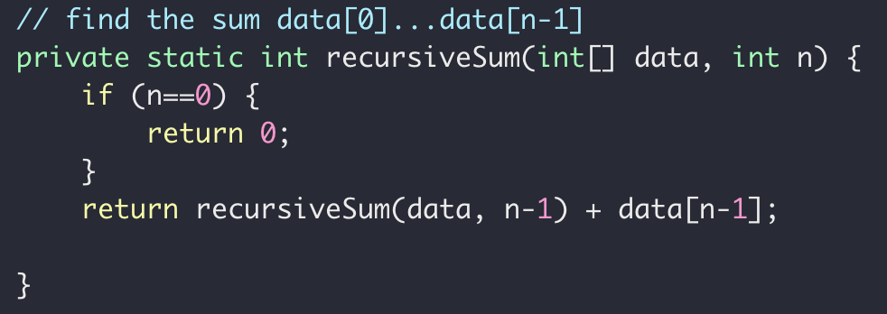
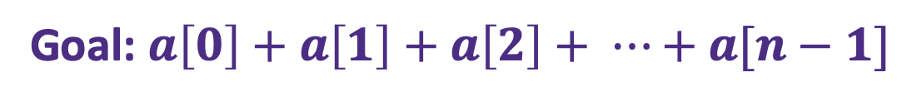


Recursive Sum
Goal: $a\left[0\right]+a\left[1\right]+a\left[2\right]+ ⋯+a[n−1]$
$sum\left(n\right)=a\left[0\right]+a\left[1\right]+ ⋯+a[n−2]+a[n−1]$
Problem
Sub-problem
$sum\left(n−1\right)=a\left[0\right]+a\left[1\right]+ ⋯+a[n−2]$
$sum\left(n−1\right)=a\left[0\right]+a\left[1\right]+ ⋯+a[n−2]$
$sum\left(n−1\right)= ?$
$sum\left(n\right)=sum(n−1)+a[n−1]$

Slide 23
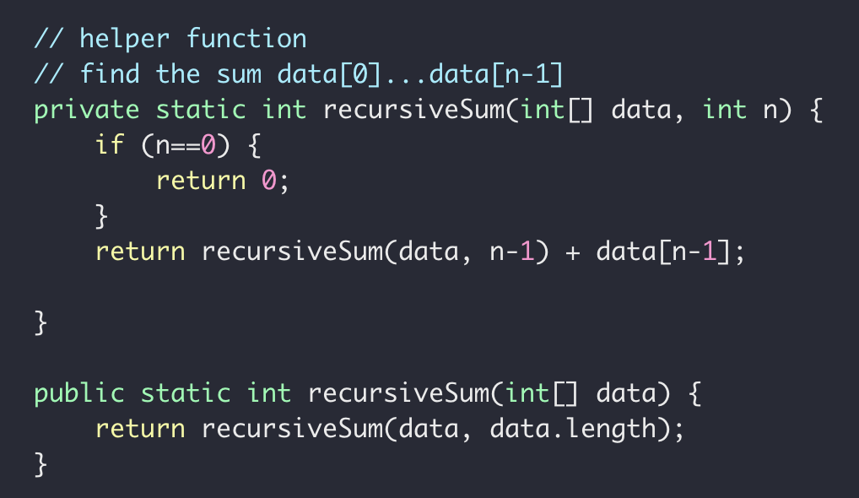
Recursive Sum
Goal: $a\left[0\right]+a\left[1\right]+a\left[2\right]+ ⋯+a[n−1]$

Slide 24

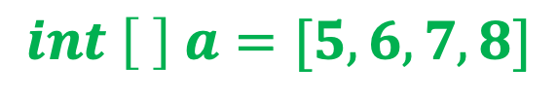


Recursive Sum
$$int \left[ \right] a=[5, 6,7,8]$$
Sum(data, 3)
Sum(data, 2)
$$=a\left[3\right]+$$
Sum(data, 1)
$$=a\left[2\right]+$$
Sum(data, 0)
$$=a\left[1\right]+$$

Slide 25
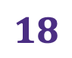

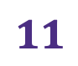



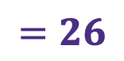
Recursive Sum
$$int \left[ \right] a=[5, 6,7,8]$$
Sum(data, 3)
$$=26$$
Sum(data, 2)
$$=8+$$
$$18$$
Sum(data, 1)
$$=7+$$
$$11$$
Sum(data, 0)
$$=6+$$
$$5$$

Slide 26
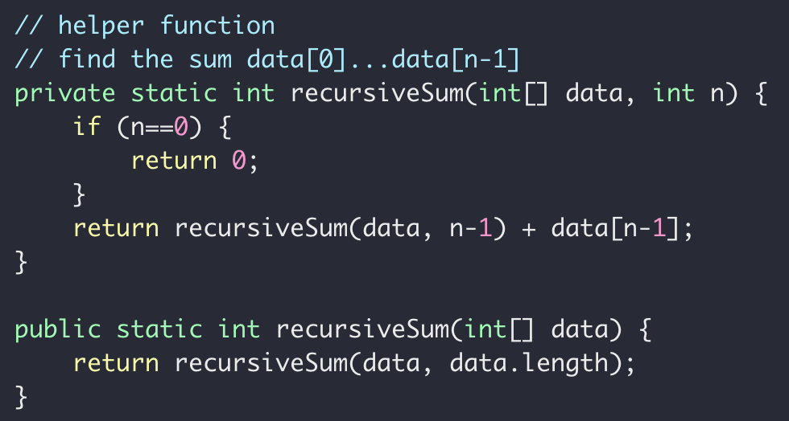
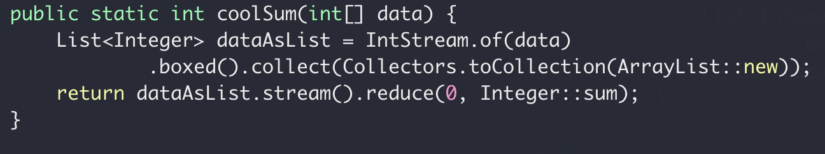
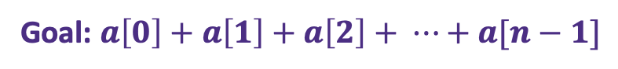
Recursive Sum
Goal: $a\left[0\right]+a\left[1\right]+a\left[2\right]+ ⋯+a[n−1]$
iterative
recursive
“modern”

Slide 27


Recursive Sum
Goal: $a\left[0\right]+a\left[1\right]+a\left[2\right]+ ⋯+a[n−1]$
Sum(data, n)
Sum(data, n-1)
$$=a\left[n−1\right]+$$
$sum\left(n\right)=a\left[n−1\right]+sum(n−1)$

Slide 28
Recursive findMax
Write a function to get the maximum of an int array
12
12
1
7
18
18
10
3
0
1
2
3
4
5
6

Slide 29
Recursion (and backtracking)
How to find the largest apple
In box 0 to 5
0
1
2
3
4
5
Largest apple:
1
1
0

Slide 30
Recursion (and backtracking)
How to find the largest apple
In box 0 to 5 (noted as [0,5])
Get the first apple from [0,5]
Find the largest apple from [1,5]
compare it with apple 0
0
1
2
3
4
5

Slide 31
Recursion (and backtracking)
How to find the largest apple
In box 1 to 5
Get the first apple from [1,5]
Find the largest apple from 2-5
compare it with apple 1
0
1
2
3
4
5

Slide 32
Recursion (and backtracking)
How to find the largest apple
In box 2 to 5
Get the first apple from [2,5]
Find the largest apple from 3-5
compare it with apple 2
0
1
2
3
4
5

Slide 33
Recursion (and backtracking)
How to find the largest apple
In box 1 to 5
Get the first apple from [3,5]
Find the largest apple from 3-5
compare it with apple 3
0
1
2
3
4
5

Slide 34
Recursion (and backtracking)
How to find the largest apple
In box 1 to 5
Get the first apple from [4,5]
Find the largest apple from 4-5
compare it with apple 4
0
1
2
3
4
5

Slide 35
Recursion (and backtracking)
How to find the largest apple
In box 1 to 5
Only 1 apple is left, it’s the largest comparing to itself
0
1
2
3
4
5

Slide 36
Recursion (and backtracking)
How to find the largest apple
In box 1 to 5
Get the first apple from [4,5]
Find the largest apple from 4-5
compare it with apple 4
0
1
2
3
4
5

Slide 37
Recursion (and backtracking)
How to find the largest apple
In box 1 to 5
Get the first apple from [4,5]
Find the largest apple from 4-5
compare it with apple 4
0
1
2
3
4
5

Slide 38
Recursion (and backtracking)
How to find the largest apple
In box 1 to 5
Get the first apple from [3,5]
Find the largest apple from 3-5
compare it with apple 3
0
1
2
3
4
5

Slide 39
Recursion (and backtracking)
How to find the largest apple
In box 1 to 5
Get the first apple from [3,5]
Find the largest apple from 3-5
compare it with apple 3
0
1
2
3
4
5

Slide 40
Recursion (and backtracking)
How to find the largest apple
In box 2 to 5
Get the first apple from [2,5]
Find the largest apple from 3-5
compare it with apple 2
0
1
2
3
4
5

Slide 41
Recursion (and backtracking)
How to find the largest apple
In box 1 to 5
Get the first apple from [1,5]
Find the largest apple from 2-5
compare it with apple 1
0
1
2
3
4
5

Slide 42
Recursion (and backtracking)
How to find the largest apple
In box 1 to 5
Get the first apple from [1,5]
Find the largest apple from 2-5
compare it with apple 1
0
1
2
3
4
5

Slide 43
Recursion (and backtracking)
How to find the largest apple
In box 1 to 5
Get the first apple from [1,5]
Find the largest apple from 2-5
compare it with apple 1
0
1
2
3
4
5

Slide 44
Recursion (and backtracking)
How to find the largest apple
In box 0 to 5 (noted as [0,5])
Get the first apple from [0,5]
Find the largest apple from [1,5]
compare it with apple 0
0
1
2
3
4
5

Slide 45
Recursion (and backtracking)
How to find the largest apple
In box 0 to 5 (noted as [0,5])
Get the first apple from [0,5]
Find the largest apple from [1,5]
compare it with apple 0
0
1
2
3
4
5

Slide 46
A similar question
Find the largest number in an array
Array not sorted
interger
0
1
2
3
4
5

Slide 47
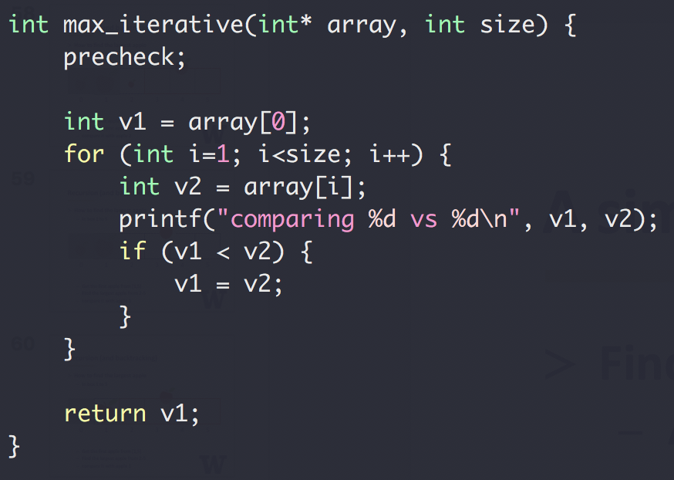
A similar question
Find the largest number in an array
Array not sorted
Integer
Method 1
Iterative

Slide 48
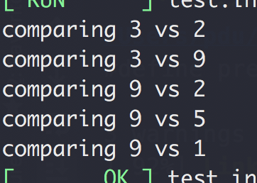
A similar question
Find the largest number in an array
Array not sorted
Integer
Method 1
Iterative
Input: [3,2,9,2,5,1]

Slide 49
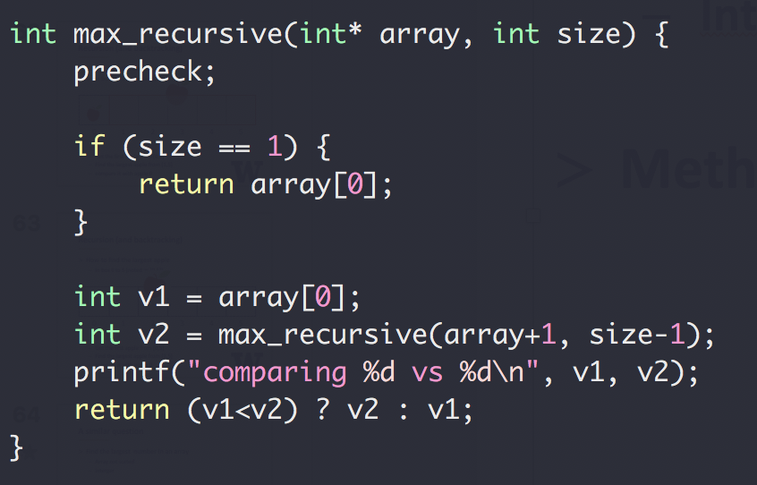
A similar question
Find the largest number in an array
Array not sorted
Integer
Method 2
Recursive

Slide 50
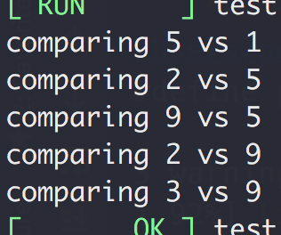
A similar question
Find the largest number in an array
Array not sorted
Integer
Method 1
Recursive
Input: [3,2,9,2,5,1]

Slide 51
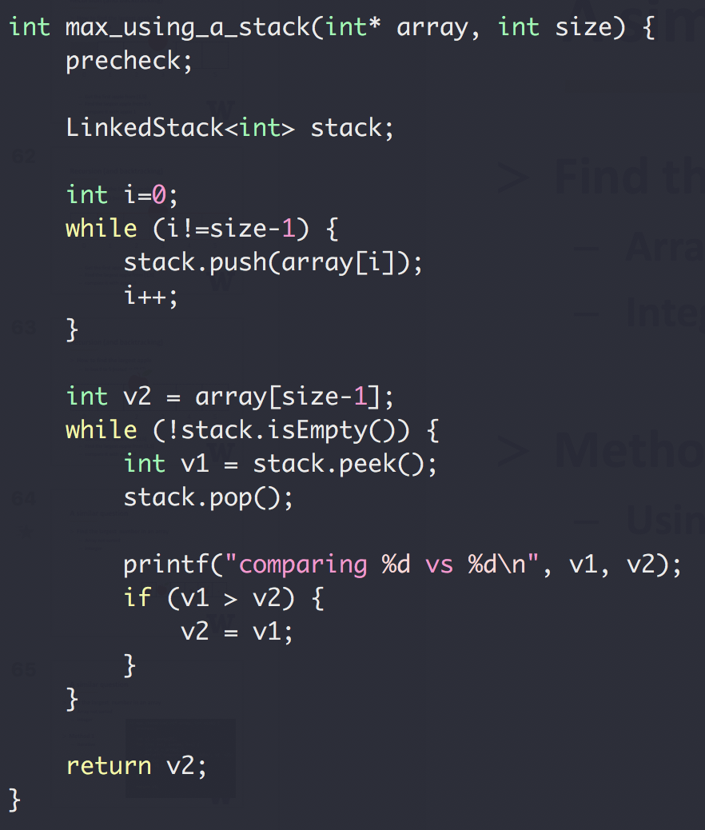
A similar question
Find the largest number in
an array
Array not sorted
Integer
Method 3
Using a stack

Slide 52
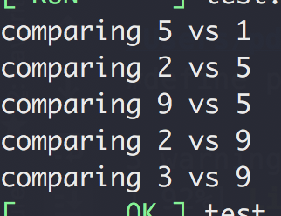
A similar question
Find the largest number in
an array
Array not sorted
Integer
Method 3
Using a stack
Input: [3,2,9,2,5,1]

Slide 53
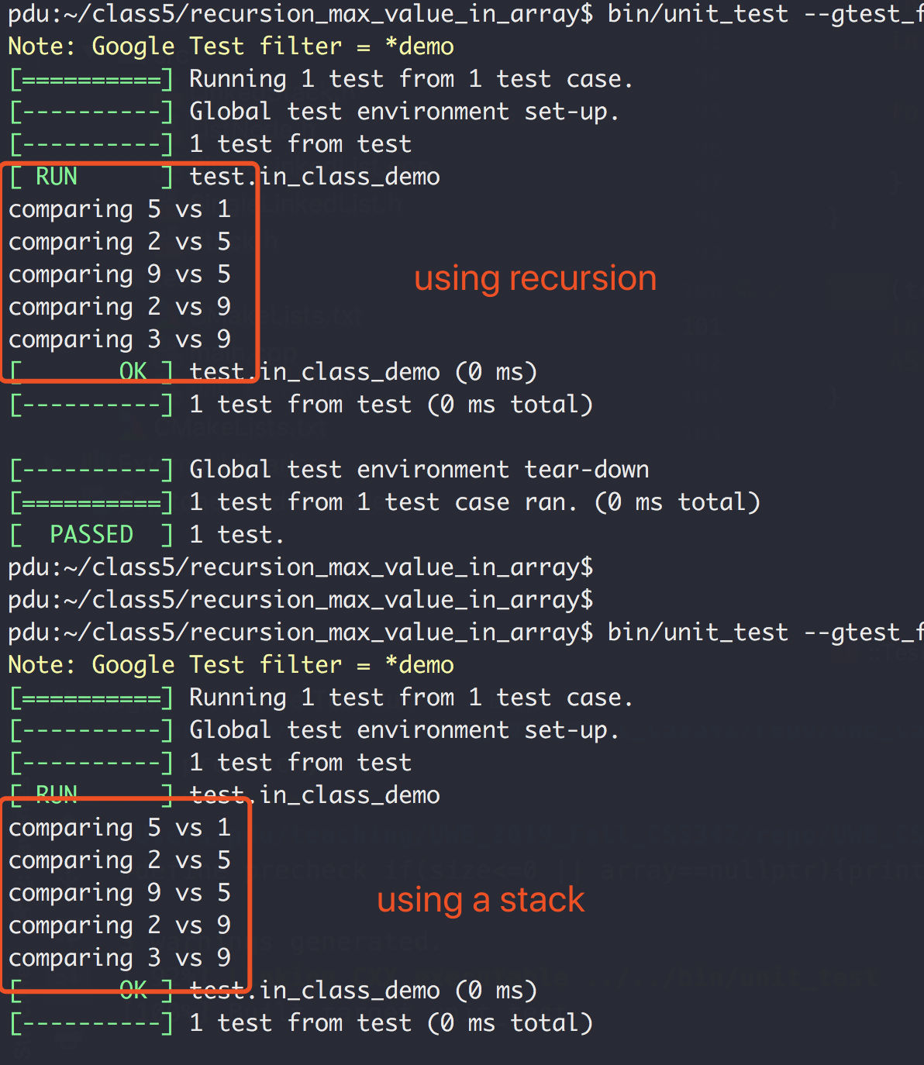
Recursion vs Stack

Slide 54
Recursion
Binary Search
Linear Search (target 12)
5 3 1 9 8 7 12 2 4
5 3 1 8 7 9 2 4 12
O(N) Can we do better?
Worse case we have to iterate N element

Slide 55
Binary Search
“Who checked that bug in?!!”
Source control svn, git, etc
1
2
3
4
5
6
7
8
9
10
Mike
Peng
Ethan

Slide 56

Binary Search
“Who checked that bug in?!!”
Source control svn, git, etc
Found a bug in version 10
No bug in version 1
?
?
?
?
?
?
?
?
1
2
3
4
5
6
7
8
9
10

Slide 57
Binary Search
Source control svn, git, etc
“Who checked that bug in?!!”
Found a bug in version 10
No bug in version 1
?
?
?
?
?
?
?
?
1
2
3
4
5
6
7
8
9
10

Slide 58
Binary Search
Source control svn, git, etc
“Who checked that bug in?!!”
Found a bug in version 10
No bug in version 1
?
?
?
?
?
?
?
?
1
2
3
4
5
6
7
8
9
10

Slide 59
Binary Search
Source control svn, git, etc
“Who checked that bug in?!!”
Found a bug in version 10
No bug in version 1
?
?
?
?
?
1
2
3
4
5
6
7
8
9
10
Bug introduced, found with 3 checks

Slide 60
Binary Search
Binary Search (target 12)
1 2 3 4 5 7 8 9 12
1 2 3 4 5 7 8 9 12
1 2 3 4 5 7 8 9 12
1 2 3 4 5 7 8 9 12
1 2 3 4 5 7 8 9 12
O(logN) both average and worst case

Slide 61
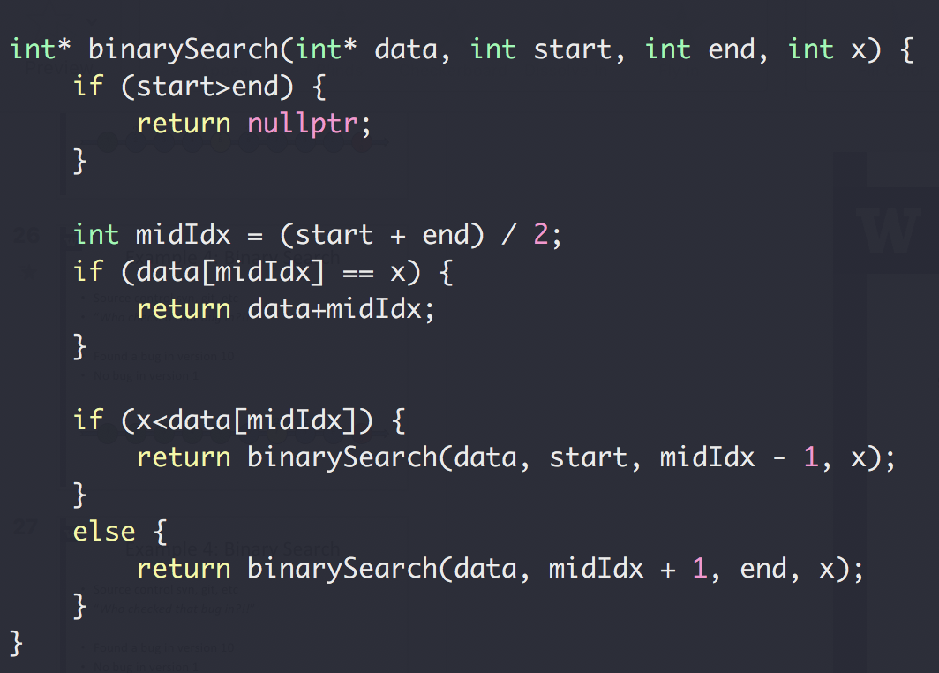
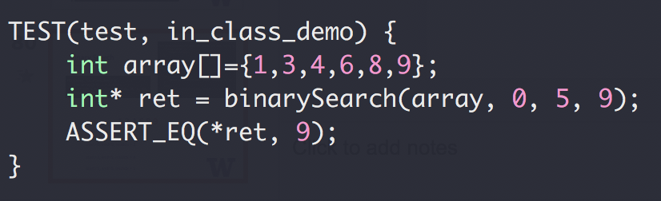
Binary Search

Slide 62
Binary Search
1,3,4,6,8,9
start=0, end=5, midIdx = 2
start=3, end=5, midIdx = 4
start=5, end=5, midIdx = 5

Slide 63
Binary Search
Up to 2³¹-1 for 32-bit signed int
What could go wrong?
The Java programming language library had this bug for 20+ years

Slide 64
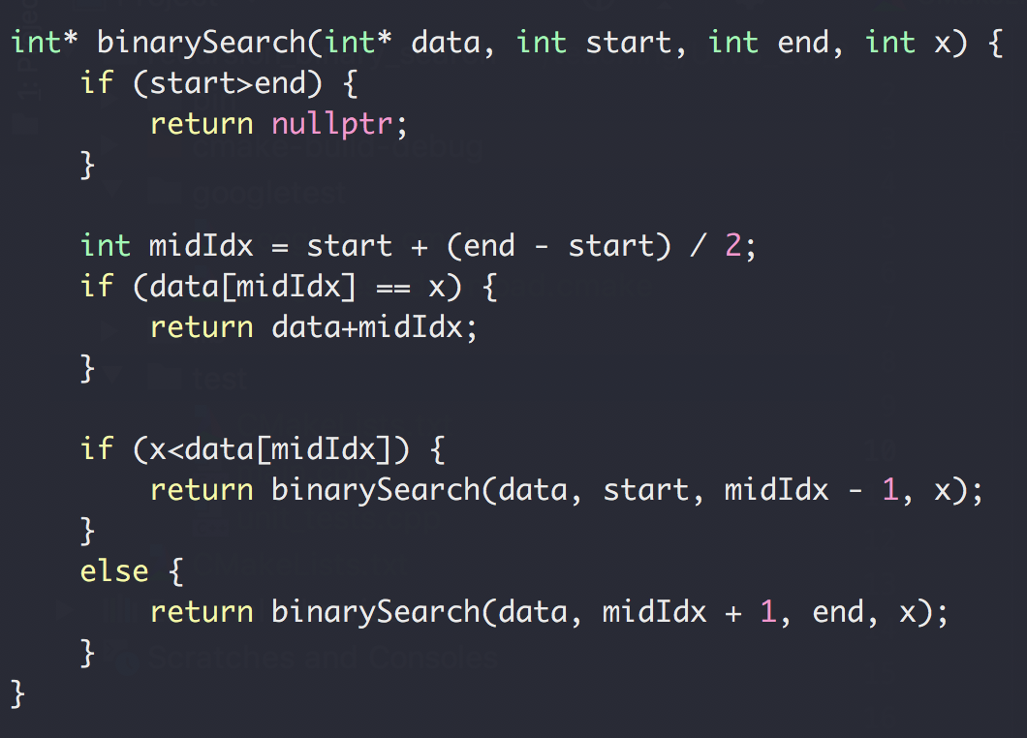
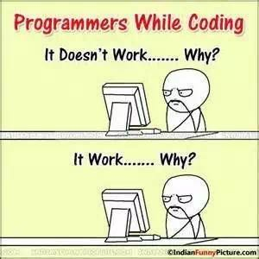
Binary Search

Slide 65
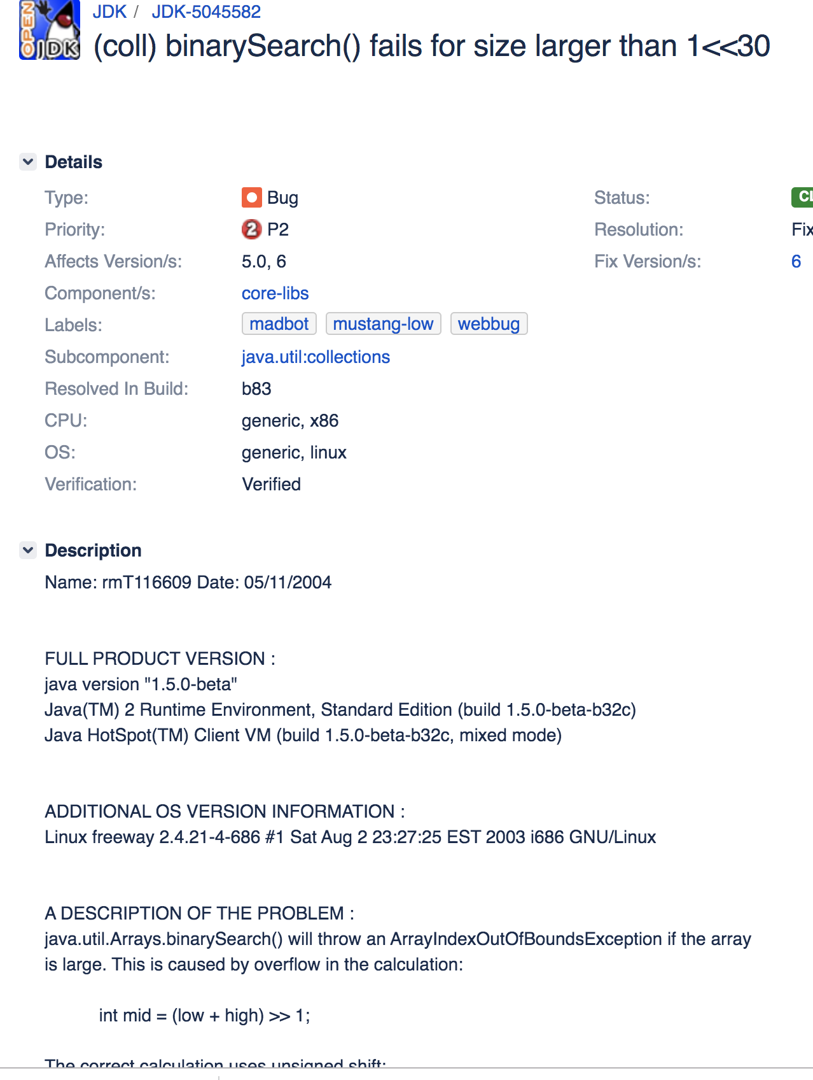
Binary Search
https://bugs.openjdk.java.net/browse/JDK-5045582

